Slide 1
أكـــــاديميــــة طــــويـــق
Scalable Data Science

Slide 2
Distributed ML with Spark MLlib
By: Dr. Afshan Hashmi

Slide 3
Course Objectives:
Understand the fundamentals of distributed computing
Gain hands-on experience with Spark MLlib,
Explore and implement supervised and unsupervised machine learning algorithms
Learn how to build, tune, and evaluate ML models
Develop the ability to optimize performance and resource

Slide 4
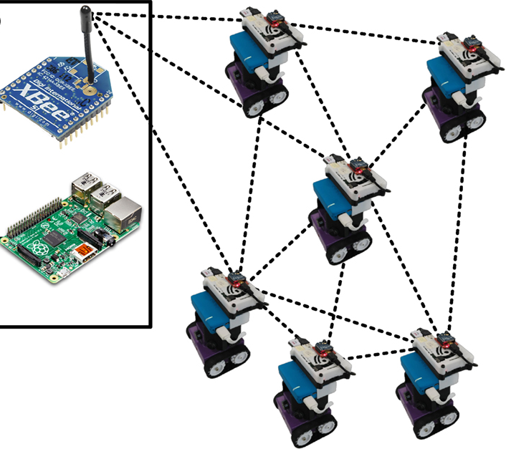
Introduction to Distributed Machine Learning
What is Distributed Machine Learning?
Distributed Machine Learning (Distributed ML) is a technique where the training and processing of machine learning models are spread across multiple computers (also called nodes or machines) instead of relying on just one machine.
Simple Analogy: Imagine trying to build a Lego city. If one person does all the work, it takes a long time. But if 10 people build different sections at the same time, the city is completed much faster. Distributed ML works the same way—with machines instead of people.

Slide 5
Why Use Distributed ML?
In today's world, machine learning models often deal with:
Massive datasets (like millions of images or billions of rows of user data).
Complex models (like deep neural networks with millions of parameters).
Trying to process these on a single machine would:
Be extremely slow.
Require more memory and power than the machine has.
Risk data loss if the machine fails.
That’s why we distribute the work across many machines, enabling efficient training and processing.

Slide 6
Key Benefits of Distributed ML
Feature | Description
🔄 Scalability | Easily handle growing datasets or model sizes by adding more machines.
⚡ Faster Processing | Multiple machines work in parallel, greatly reducing training time.
🛠️ Fault Tolerance | If one machine fails, others can take over without crashing the system.
⚙️ Parallelism | Different parts of the task (like data batches or model layers) are processed simultaneously.

Slide 7
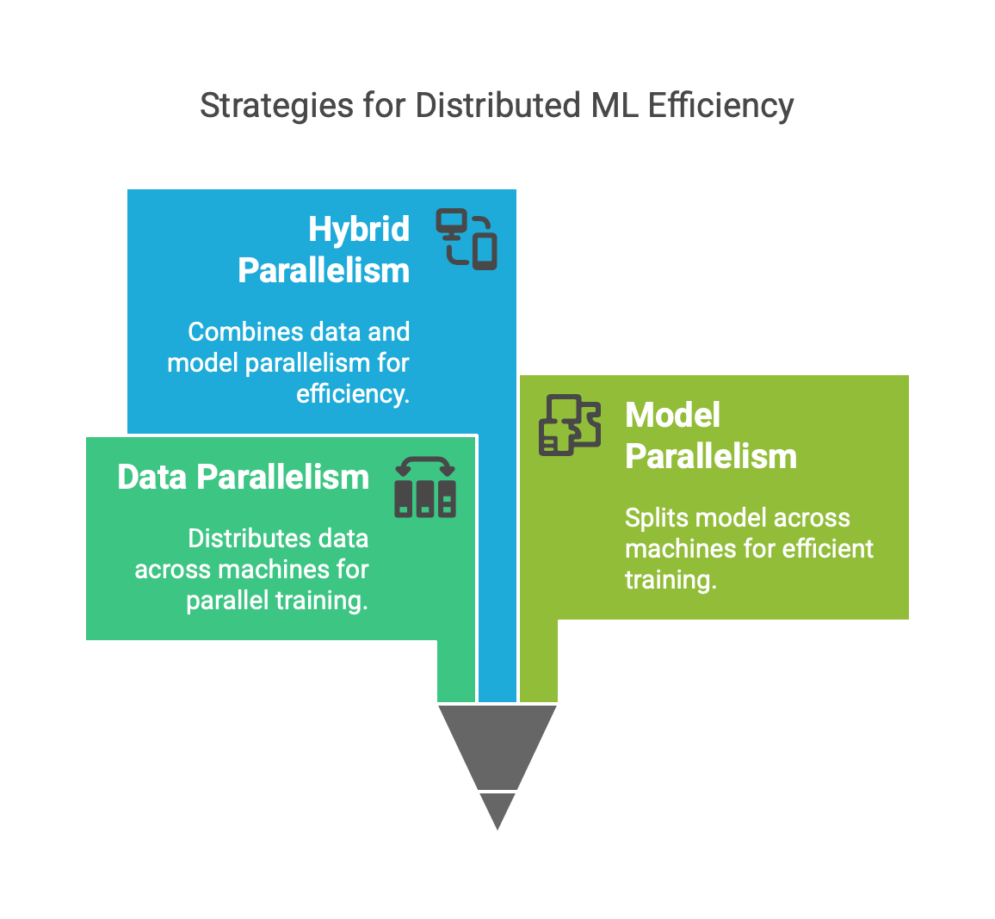
How Does It Work?
Distributed ML typically uses:
Data Parallelism: Each machine trains on a different portion of the data using the same model, then synchronizes the results (like weights).
Model Parallelism: A single large model is split across machines; each machine trains a part of the model.
Hybrid Parallelism: Combination of both data and model parallelism.

Slide 8
Popular Tools & Frameworks
Tool | Use
TensorFlow Distributed | Distributed training for neural networks.
PyTorch Distributed | Flexible distributed computing for research and production.
Apache Spark MLlib | Scalable ML on big data with cluster computing.
Horovod | Distributed deep learning framework originally built by Uber.

Slide 9
Real-World Examples
Google Translate: Trained across thousands of machines using data from multiple languages.
Self-Driving Cars: Models trained with distributed frameworks using video feeds from millions of driving hours.
Amazon & Netflix: Distributed recommendation systems trained using huge datasets of user preferences.

Slide 10
Introduction to Apache Spark
What is Apache Spark?
Apache Spark is an open-source, distributed computing system designed for fast and scalable data processing. It provides a unified engine that supports both batch and real-time analytics over large datasets, making it a go-to solution for Big Data processing and machine learning pipelines.
Key Features:
High-Speed Processing: Performs in-memory computations (RAM instead of disk), which makes it up to 100x faster than traditional big data systems like Hadoop MapReduce.
Ease of Use: Offers APIs in Python (PySpark), Java, Scala, and R.
Versatility: Supports diverse workloads – ETL, streaming, graph processing, SQL, and machine learning – all within one framework.

Slide 11
Core Components of Apache Spark
Component | Description
Spark Core | The base engine that provides task scheduling, memory management, fault recovery, I/O operations, and interaction with storage systems like HDFS or S3. All other components are built on top of Spark Core.
Spark SQL | Module for structured data processing. Supports running SQL queries, as well as reading from/writing to different file formats (CSV, Parquet, ORC, JSON). It allows seamless integration with BI tools.
Spark Streaming | Enables real-time processing of live data streams (e.g., from Kafka, Flume, or TCP sockets). It processes data in small micro-batches, providing near real-time analytics.
Spark MLlib | A scalable Machine Learning library offering a wide range of algorithms for classification, regression, clustering, and collaborative filtering, along with tools for feature extraction and model evaluation.
GraphX | Spark’s graph computation engine, used for graph-parallel operations and algorithms (e.g., PageRank, shortest path). Useful in analyzing social networks or network structures.

Slide 12
Why Use Apache Spark?
Designed for high-volume data workloads.
Works with multiple cluster managers: Hadoop YARN, Apache Mesos, Kubernetes, or standalone.
Integrates with data lakes, databases, cloud storage, and streaming platforms.
Example Use Case:
Scenario: A bank wants to detect fraudulent transactions in real-time.
Use Spark Streaming to ingest transaction data from Kafka.
Apply Spark MLlib to classify transactions using a trained fraud detection model.
Store and query results using Spark SQL.

Slide 13
Spark MLlib Overview
What is MLlib?
MLlib (Machine Learning Library) is Apache Spark’s scalable machine learning library. It provides a wide range of machine learning algorithms and utilities that are distributed across clusters, making it highly efficient for handling large datasets.
MLlib is designed to scale easily with big data, enabling developers and data scientists to build and deploy models on massive datasets without managing distributed systems manually.
Built on Spark Core (RDDs/DataFrames).
Supports:
Classification, Regression, Clustering (e.g., Logistic Regression, K-Means).
Feature Engineering (PCA, Tokenization).
Pipelines (end-to-end ML workflows).
MLlib vs. Other Libraries
Feature | Spark MLlib | scikit-learn | TensorFlow/PyTorch
Scalability | Distributed (100s of nodes) | Single-node | Multi-GPU/TPU
Ecosystem | Spark (ETL + ML) | Standalone | Deep Learning focus

Slide 14
What Can You Do with MLlib?
MLlib supports:
Category | Algorithms / Techniques
Classification | Logistic Regression, Random Forest, Decision Trees, Naive Bayes
Regression | Linear Regression, Generalized Linear Regression
Clustering | K-means, Gaussian Mixture Models
Collaborative Filtering | ALS (Alternating Least Squares) for recommendation systems
Dimensionality Reduction | PCA (Principal Component Analysis), SVD (Singular Value Decomposition)
Feature Extraction & Transformation | Tokenizer, Word2Vec, StandardScaler, StringIndexer, OneHotEncoder
Model Evaluation | Cross-validation, Train-validation split, Evaluation metrics like accuracy, RMSE, precision

Slide 15
Supported Languages
You can use MLlib with multiple languages:
Scala – Native and most optimized.
Python (PySpark) – Popular among data scientists and Python developers.
Java – For enterprise-grade applications.
R – For statistical computing and analysis (via SparkR or Sparklyr).

Slide 16
Key Features of MLlib
1. Scalable and Distributed Algorithms
All algorithms are parallelized across clusters using Spark’s distributed processing engine.
Allows training models on terabytes of data without running into memory issues.
2. ML Pipelines (Inspired by Scikit-learn)
MLlib uses a high-level Pipeline API to create machine learning workflows.
Components include:
Transformers (e.g., StandardScaler)
Estimators (e.g., LogisticRegression)
Evaluators (e.g., BinaryClassificationEvaluator)
Enables chaining together multiple stages: preprocessing → training → evaluation → tuning.
3. Tight Integration with Spark SQL and DataFrames
MLlib supports DataFrame-based APIs, making it easier to preprocess structured data.
You can perform SQL queries, data wrangling, and ML model training within the same environment.

Slide 17
Advantages of MLlib
Handles Big Data Efficiently – Can process data that wouldn’t fit into memory on a single machine.
Unified Stack – Integrates well with other Spark components like Spark SQL and Streaming.
Easy to Scale – Just add more nodes to the cluster to improve performance.
When to Use MLlib?
You need to apply machine learning on big datasets (millions of records).
You want end-to-end pipelines for data ingestion, transformation, modeling, and evaluation.
You need scalability and distributed computing without managing the complexity of setting it up yourself.

Slide 18
MLlib Architecture – A Deep Dive
Apache Spark MLlib is built to streamline the end-to-end machine learning pipeline in a distributed, scalable, and high-performance environment.
Raw Data → DataFrame → Feature Transformation → ML Model → Evaluation → Prediction
This pipeline resembles a real-world machine learning workflow and consists of the following stages:
Step | Description
Raw Data | Input collected from various sources (CSV, JSON, Hive, etc.)
DataFrame | Structured, tabular representation of data (like a table in a database)
Feature Transformation | Preprocessing features using transformers
ML Model | Training model using classification, regression, clustering, etc.
Evaluation | Assessing model accuracy and performance
Prediction | Using the model to infer outcomes on unseen data

Slide 19
Main Components of MLlib Architecture
DataFrames & Pipelines
DataFrames: Core data structure in Spark (like Pandas DataFrame but distributed).
Enables efficient, distributed computations.
Supports schema, data types, and SQL-like querying.
Pipeline API: Allows chaining multiple stages (like Scikit-learn):
Pipeline(stages=[Stage1, Stage2, ..., StageN])
Manages both data preprocessing and model training in a unified structure.

Slide 20
Main Components of MLlib Architecture
2. Feature Transformers
Transformers convert raw data into features usable by ML algorithms:
Transformer | Description | Use Case
VectorAssembler | Combines multiple feature columns into a single vector column | Required for feeding features into ML models
StringIndexer | Converts string labels into numerical indices | Used for categorical labels
OneHotEncoder | Converts indexed categories into binary vectors | Useful for nominal categorical variables
StandardScaler | Standardizes features (zero mean, unit variance) | Normalization before ML training
MinMaxScaler | Scales values between 0 and 1 | Useful for neural networks or logistic regression
assembler = VectorAssembler(inputCols=["age", "income"], outputCol="features")
indexer = StringIndexer(inputCol="gender", outputCol="gender_index")

Slide 21
Main Components of MLlib Architecture
3. Machine Learning Algorithms
MLlib supports a wide variety of scalable ML algorithms:
Category | Algorithm | Use Case
Classification | LogisticRegression, DecisionTreeClassifier, RandomForestClassifier | Spam detection, sentiment analysis
Regression | LinearRegression, GBTRegressor | Price prediction, demand forecasting
Clustering | KMeans, BisectingKMeans, GaussianMixture | Customer segmentation
Recommendation | ALS (Alternating Least Squares) | Product or movie recommendations
Dimensionality Reduction | PCA, SVD | Feature selection, visualization
from pyspark.ml.classification import LogisticRegression
lr = LogisticRegression(featuresCol="features", labelCol="label")

Slide 22
Main Components of MLlib Architecture
4. Evaluators
Used to evaluate model performance:
Evaluator | Suitable For | Metrics
BinaryClassificationEvaluator | Binary classification | Area Under ROC, Area Under PR
MulticlassClassificationEvaluator | Multi-class classification | Accuracy, F1 Score, Precision, Recall
RegressionEvaluator | Regression models | RMSE, MAE, R²
from pyspark.ml.evaluation import BinaryClassificationEvaluator
evaluator = BinaryClassificationEvaluator(labelCol="label", metricName="areaUnderROC")

Slide 23
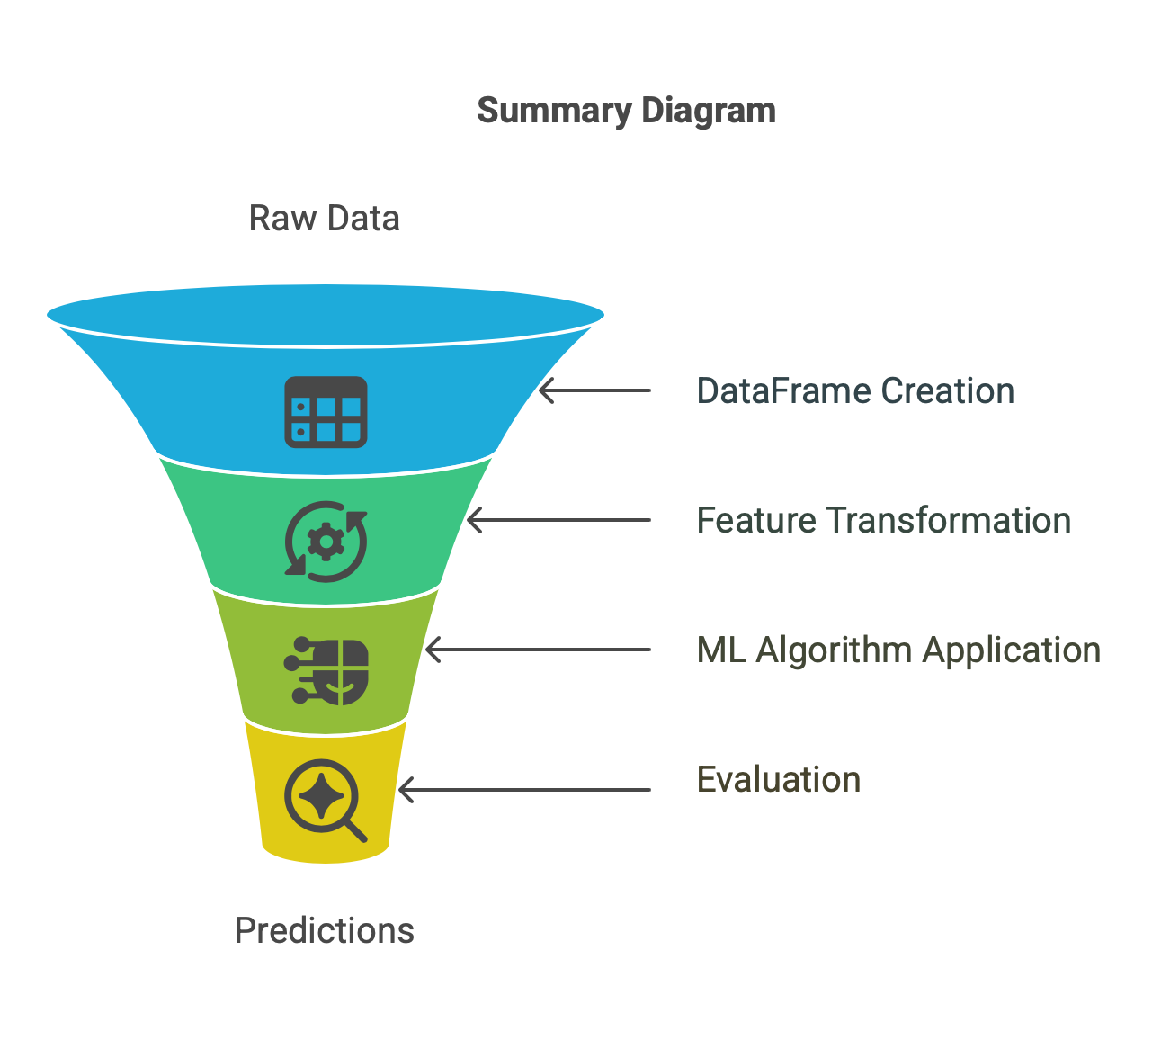
MLlib Architecture

Slide 24
Commonly Used Algorithms in MLlib
Task | Algorithms
Classification | - Logistic Regression: Ideal for binary classification tasks. - Decision Tree: Handles both categorical and numerical features. - Random Forest: Ensemble method for better accuracy and less overfitting.
Regression | - Linear Regression: Predicts continuous outcomes using a linear relationship. - Decision Tree Regression: Non-linear modeling that can capture complex patterns in the data.
Clustering | - K-Means: Unsupervised learning algorithm to group data into k clusters based on similarity.
Recommendation | - ALS (Alternating Least Squares): Matrix factorization-based collaborative filtering for recommendation systems (e.g., movie or product recommendations).
Feature Engineering | - PCA (Principal Component Analysis): Dimensionality reduction by extracting principal components. - ChiSqSelector: Selects top features based on chi-square statistical test for categorical labels.

Slide 25
Hands-on Example:MLlib Taxi: Scalable Trip Time Forecasting Click here for the lab https://drive.google.com/file/d/1nsrMt-wQYqho_nNg9pxqLz6JhMh42n0l/view?usp=share_link

Slide 26
Summary:
Key Takeaways
Spark MLlib is scalable, distributed, and fast for ML tasks on big data
Provides APIs for feature engineering, model training, and evaluation
Great alternative to Scikit-learn for large-scale ML

Slide 27
Academic References
MLlib Official Documentation
Databricks Learning Resources
[Book] Advanced Analytics with Spark – O’Reilly
PySpark Examples GitHub Repo

Slide 28

















الشراكات العالمية

Slide 29
شــــــكــــرًا لكــــــم
THANK YOU

